Slide 1



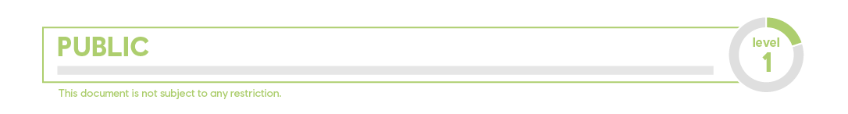
Introduction to Topic Modeling techniques
Maxime Sazadaly (maxime.sazadaly@ext.esiea.fr)

Slide 2


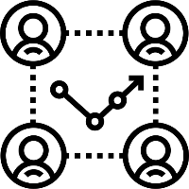



WHAT IS TEXT MINING?
SENTIMENT ANALYSIS
DOCUMENT SUMMARIZATION
NAMED ENTITIES ASSOCIATION
TOPIC MODELING
… and many other things!

Slide 3

SUMMARY
PART | 1 What is it?
PART | 2
A little bit of history
PART | 3
State of the art
PART | 4
Vizualisation

Slide 4

PART | 1
WHAT IS TOPIC MODELING?

Slide 5
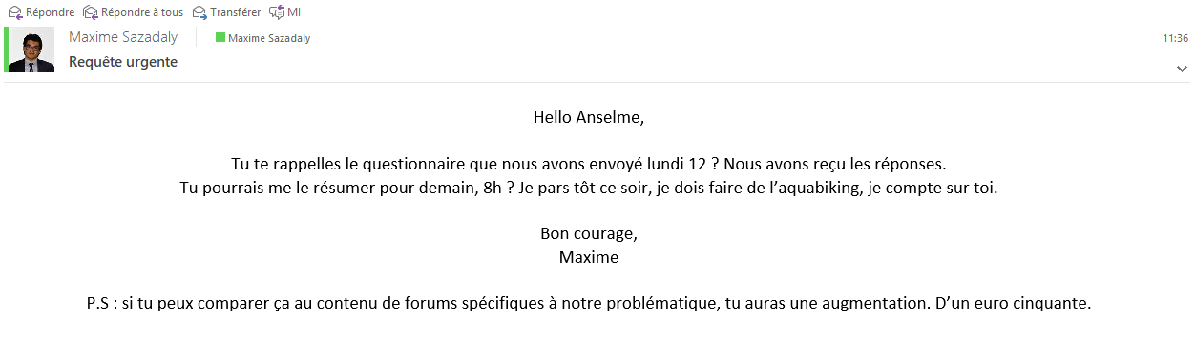

THE STORY OF ANSELME
Anselme Apatchans

Slide 6




THE STORY OF ANSELME
DETECT THE SUBJECTS DISCUSSED IN A LARGE AMOUNT OF TEXTS
MINIMAL HUMAN INTERVENTION
FAST AND RELIABLE

Slide 7

PART | 2
A LITTLE BIT OF HISTORY

Slide 8
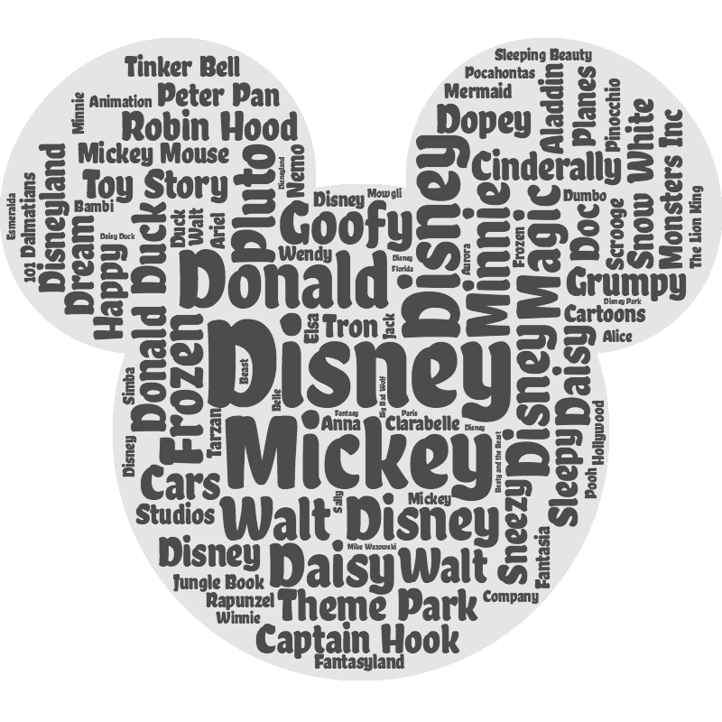
BAG OF WORDS MODELS
Documents are considered as an unordered list of words
Semantical context isn’t taken into account
Focus on the occurrences of each individual word to qualify the set of documents
Most basic model is the word cloud
Y. Zhang, R. Jin, and Z.-H. Zhou, “Understanding bag-of-words model: a statistical framework,” International Journal of Machine Learning and Cybernetics, vol. 1, no. 1-4, pp. 43–52, 2010.

Slide 9
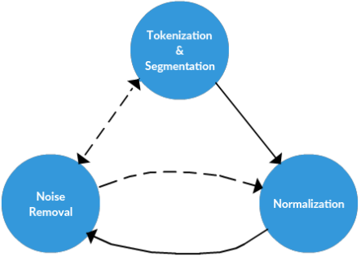
ON THE IMPORTANCE OF PREPROCESSING
words need to be encoded as values in order to be used by algorithms
tokenization is the task of chopping down documents into pieces, such as words or bigrams
segmentation is the process of refining the chunks in meaningful units (part of speech tagging, etc.)
word normalization converts words to their root word (stemming, lemmatization)
R. Feldman and J. Sanger, “Text Mining Preprocessing Techniques,” The Text Mining Handbook, pp. 57–63, 2002.

Slide 10
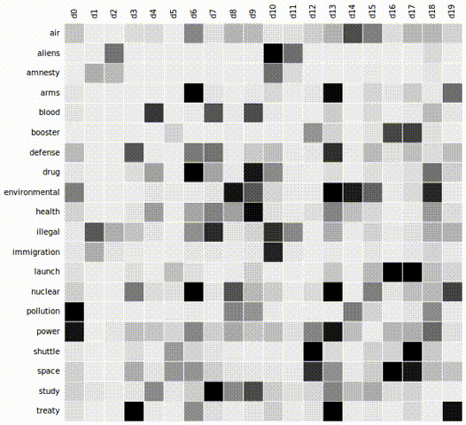
BEYOND HISTOGRAMS: LATENT SEMANTIC ANALYSIS
FIRST commonly used topic modeling system
BASED ON word / document co-occurrence matrices
Regroup DOCUMENTS BASED ON THE SIMILARITY OF THEIR WORD VECTORS,
Then regroup words based on the similarity of their document vectors
P. Wiemer-Hastings, “Introduction to Latent Semantic Analysis,” Encyclopedia of Language & Linguistics, pp. 706–709, 2006.

Slide 11

PART | 3
STATE OF THE ART

Slide 12
BEYOND LSA: LATENT DIRICHLET ALLOCATION
I like to eat brocoli and bananas.
I ate a banana and spinach smoothie for breakfast
Chinchillas are so cute.
My sister adopted a kitten yesterday!
Look at this cute piece of a hamster munching on a brocoli.
100% Topic A
100% Topic A
100% Topic B
100% Topic B
60% Topic A and 40%Topic B
→ Topic A is defined by: 30% brocoli, 15% banana, 10% breakfast, etc. (Can be identified as food!)
→ Topic B is defined by: 20% chinchillas, 20% kittens, 15% cute, etc. (Can be identified as cute animals!)
D. M. Blei, ‘Latent Dirichlet Allocation’, Journal of Machine Learning Research, pp. 30, 2003
Notes:
De par son fonctionnement, celle-ci peut être apparentée à un modèle probabiliste bayésien générateur de corpus. La modélisation effectuée par la LDA repose sur l’attribution aléatoire d’un thème à chaque mot de chaque document, suivant une loi de Dirichlet.
Une loi de Dirichlet est une distribution de probabilité multinomiale continue paramétrée par un vecteur α de k nombres réels positifs
En itérant cette opération un grand nombre de fois, les différentes assignations de thèmes à chaque mot se stabilisent / convergent et il est alors possible de déterminer le sujet de chaque document M en comptant le nombre de mots étant associés à chaque topic. De même, les mots représentant le plus efﬁcacement chaque topic peuvent être retrouvés en prenant les mots les plus souvent associés à chaque thèmes.
Les différentes variables intervenant dans ce modèle sont les suivantes : α est le paramètre de la distribution de Dirichlet relative à l’assignation des topics par documents ;β est le paramètre de la distribution de Dirichlet relative à l’assignation des mots par topics ;θM est la distribution de topics pour un document M ;φk est la distribution de mots pour un topic k ; zMN est le topic du n-ième mot du document M ; et wMN est le mot correspondant à l’itération actuelle.

Slide 13
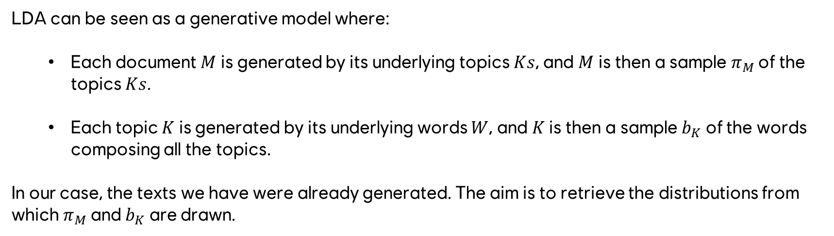
BEYOND LSA: LATENT DIRICHLET ALLOCATION
LDA can be seen as a generative model where:
Each document $M$ is generated by its underlying topics $Ks$, and $M$ is then a sample $π_{M}$ of the topics $Ks$.
Each topic $K$ is generated by its underlying words $W$, and $K$ is then a sample $b_{K}$ of the words composing all the topics.
In our case, the texts we have were already generated. The aim is to retrieve the distributions from which $π_{M}$ and $b_{K}$ are drawn.
D. M. Blei, ‘Latent Dirichlet Allocation’, Journal of Machine Learning Research, pp. 30, 2003
Notes:
De par son fonctionnement, celle-ci peut être apparentée à un modèle probabiliste bayésien générateur de corpus. La modélisation effectuée par la LDA repose sur l’attribution aléatoire d’un thème à chaque mot de chaque document, suivant une loi de Dirichlet.
Une loi de Dirichlet est une distribution de probabilité multinomiale continue paramétrée par un vecteur α de k nombres réels positifs
En itérant cette opération un grand nombre de fois, les différentes assignations de thèmes à chaque mot se stabilisent / convergent et il est alors possible de déterminer le sujet de chaque document M en comptant le nombre de mots étant associés à chaque topic. De même, les mots représentant le plus efﬁcacement chaque topic peuvent être retrouvés en prenant les mots les plus souvent associés à chaque thèmes.
Les différentes variables intervenant dans ce modèle sont les suivantes : α est le paramètre de la distribution de Dirichlet relative à l’assignation des topics par documents ;β est le paramètre de la distribution de Dirichlet relative à l’assignation des mots par topics ;θM est la distribution de topics pour un document M ;φk est la distribution de mots pour un topic k ; zMN est le topic du n-ième mot du document M ; et wMN est le mot correspondant à l’itération actuelle.

Slide 14
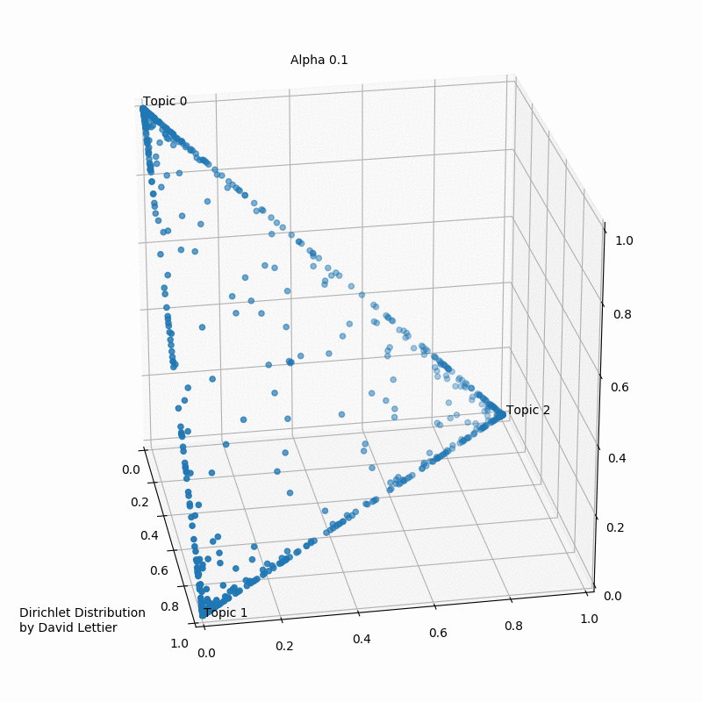
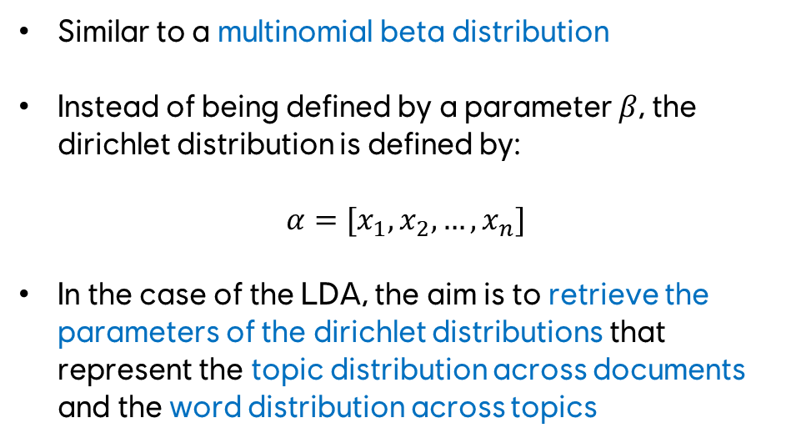
LDA KEY COMPONENT: DIRICHLET DISTRIBUTION
Similar to a multinomial beta distribution
Instead of being defined by a parameter $β$, the dirichlet distribution is defined by:
$$α=[x_{1},x_{2}, …,x_{n}]$$
In the case of the LDA, the aim is to retrieve the parameters of the dirichlet distributions that represent the topic distribution across documents and the word distribution across topics
D. M. Blei, ‘Latent Dirichlet Allocation’, Journal of Machine Learning Research, pp. 30, 2003

Slide 15
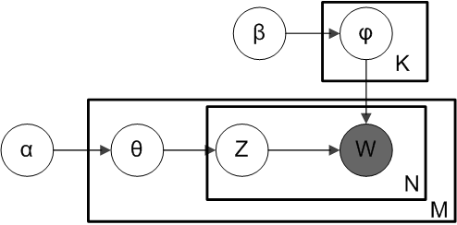
LDA KEY COMPONENT: GIBBS SAMPLING
Given a document M composed of words Ws and assigned to a thema K we can calculate:
P(K|M) : probability of M being associated to K
P(W|K) : probability of K being associated to W
Then, we can calculate the probability of K generating the word W inside the document M :
P(W|K) * P(K|M)
By iterating numerous time, the system converges to a stable representation of the documents
D. M. Blei, ‘Latent Dirichlet Allocation’, Journal of Machine Learning Research, pp. 30, 2003
Notes:
α est le paramètre de la distribution de Dirichlet relative à l’assignation des topics par documents ;β est le paramètre de la distribution de Dirichlet relative à l’assignation des mots par topics ;θM est la distribution de topics pour un document M ;φk est la distribution de mots pour un topic k ; zMN est le topic du n-ième mot du document M ; et wMN est le mot correspondant à l’itération actuelle.

Slide 16
PROBLEMS LINKED TO LDA
1
PERFORMANCES ON SHORT TEXTS IS HEAVILY DISCUTABLE
2
DOESN’T DEAL WITH TOPIC EVOLUTION OVERTIME (DYNAMIC TOPIC MODELING)
3
DOESN’T TAKE SEMANTICAL RELATIONSHIPS INTO ACCOUNT
N. Naveed, T. Gottron, J. Kunegis, A. Che Alhadi, “Searching microblogs: Coping with sparsity and document quality”, CIKM’11: Proceedings of 20th ACM Conference on Information and Knowledge Management, pp. 183–188, 2011

Slide 17
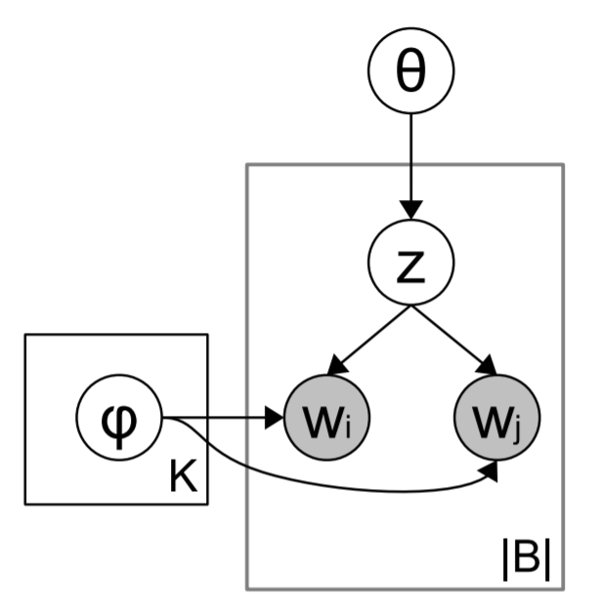
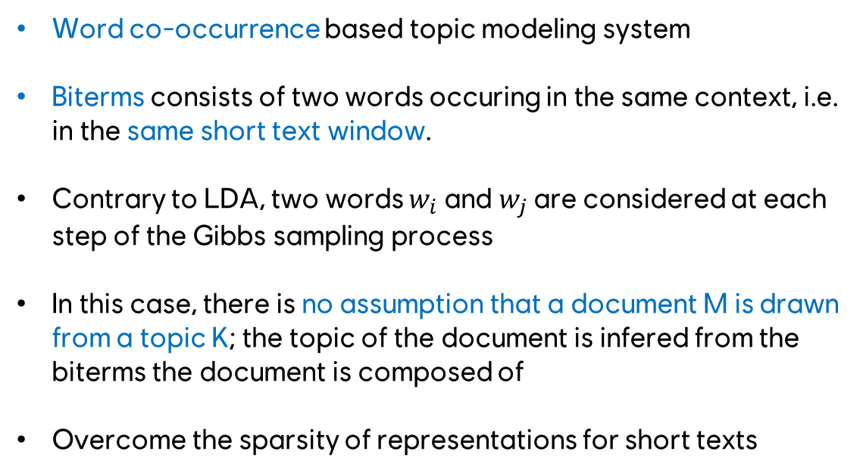
OVERCOMING SHORT TEXTS: BITERM TOPIC MODELING
Word co-occurrence based topic modeling system
Biterms consists of two words occuring in the same context, i.e. in the same short text window.
Contrary to LDA, two words $w_{i}$ and $w_{j}$ are considered at each step of the Gibbs sampling process
In this case, there is no assumption that a document M is drawn from a topic K; the topic of the document is infered from the biterms the document is composed of
Overcome the sparsity of representations for short texts
X. Yan, J. Guo, Y. Lan, and X. Cheng, “A Biterm Topic Model for Short Texts”, p. 11, 2016.

Slide 18
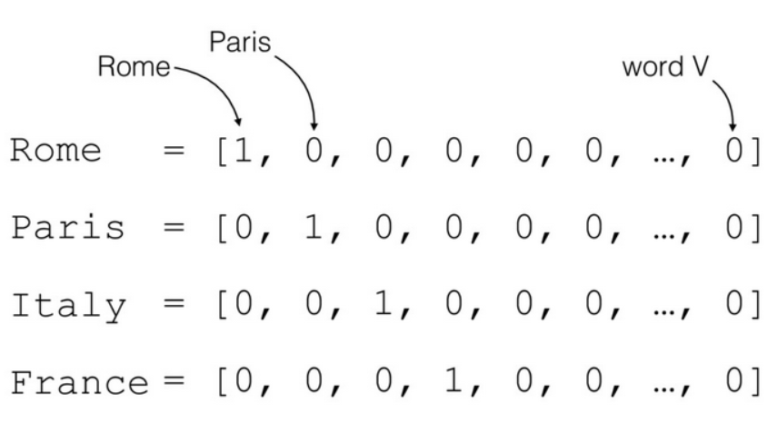
UNDERSTANDING WORD RELATIONSHIPS: WORD2VEC
Words are usually one-hot encoded
Not efficient at all for semantic-based relationships
Have a good day and Have a great morning are in fact really close in meaning, but their matrix representation will be too different
C. E. Moody, “Mixing Dirichlet Topic Models and Word Embeddings to Make lda2vec,” CoRR, vol. abs/1605.02019, 2016.

Slide 19
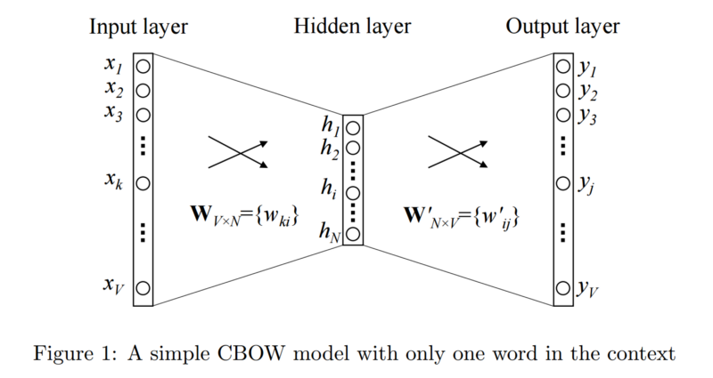
UNDERSTANDING WORD RELATIONSHIPS: WORD2VEC
Word2Vec is a model in which words with a similar meaning occupy close spacial positions
Models the dependencies between words
Two variants exist : CBOW which is good at modeling words that occur often and SkipGrams which models rare words well.
Each word is predicted by using all the words present in the sentence, called Context Words
In this space, king - man + woman = queen
Tensorflow projector
C. E. Moody, “Mixing Dirichlet Topic Models and Word Embeddings to Make lda2vec,” CoRR, vol. abs/1605.02019, 2016.

Slide 20
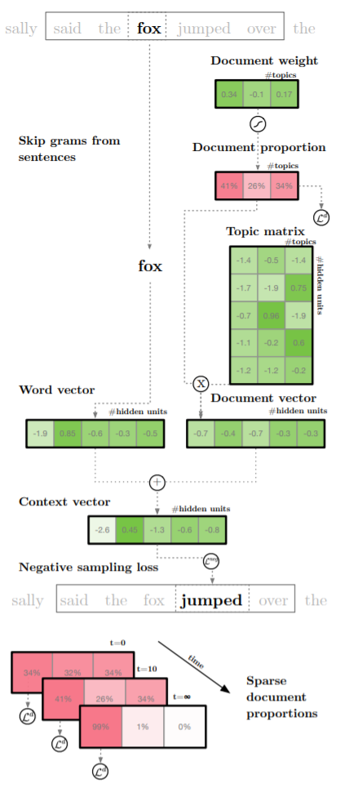
REUNITING WITH SEMANTIC RELATIONSHIPS: LDA2VEC
Tweaks the Word2Vec SkipGram architecture to utilize document-wide feature vectors
Embeds both words and document vectors into the same space. If a word is related to subject A and the document is related to subject B, the topic associated to a word W of the document will be more likely to be A or B.
Outputs are similar to a classic LDA
C. E. Moody, “Mixing Dirichlet Topic Models and Word Embeddings to Make lda2vec,” CoRR, vol. abs/1605.02019, 2016.

Slide 21
OVERCOMING EVOLUTION OVER TIME: HIERARCHICAL DIRICHLET PROCESS
?

Slide 22

PART | 4
VISUALIZATION

Slide 23

AN ALGORITHM TAKE ON VISUALIZATION: T-SNE
Dimension reduction
NON-LINEAR
MAXIMIZE SIMILARITY BETWEEN MATRICES
Maaten, Laurens van der and Geoffrey E. Hinton. “Visualizing Data using t-SNE.” (2008).

Slide 24
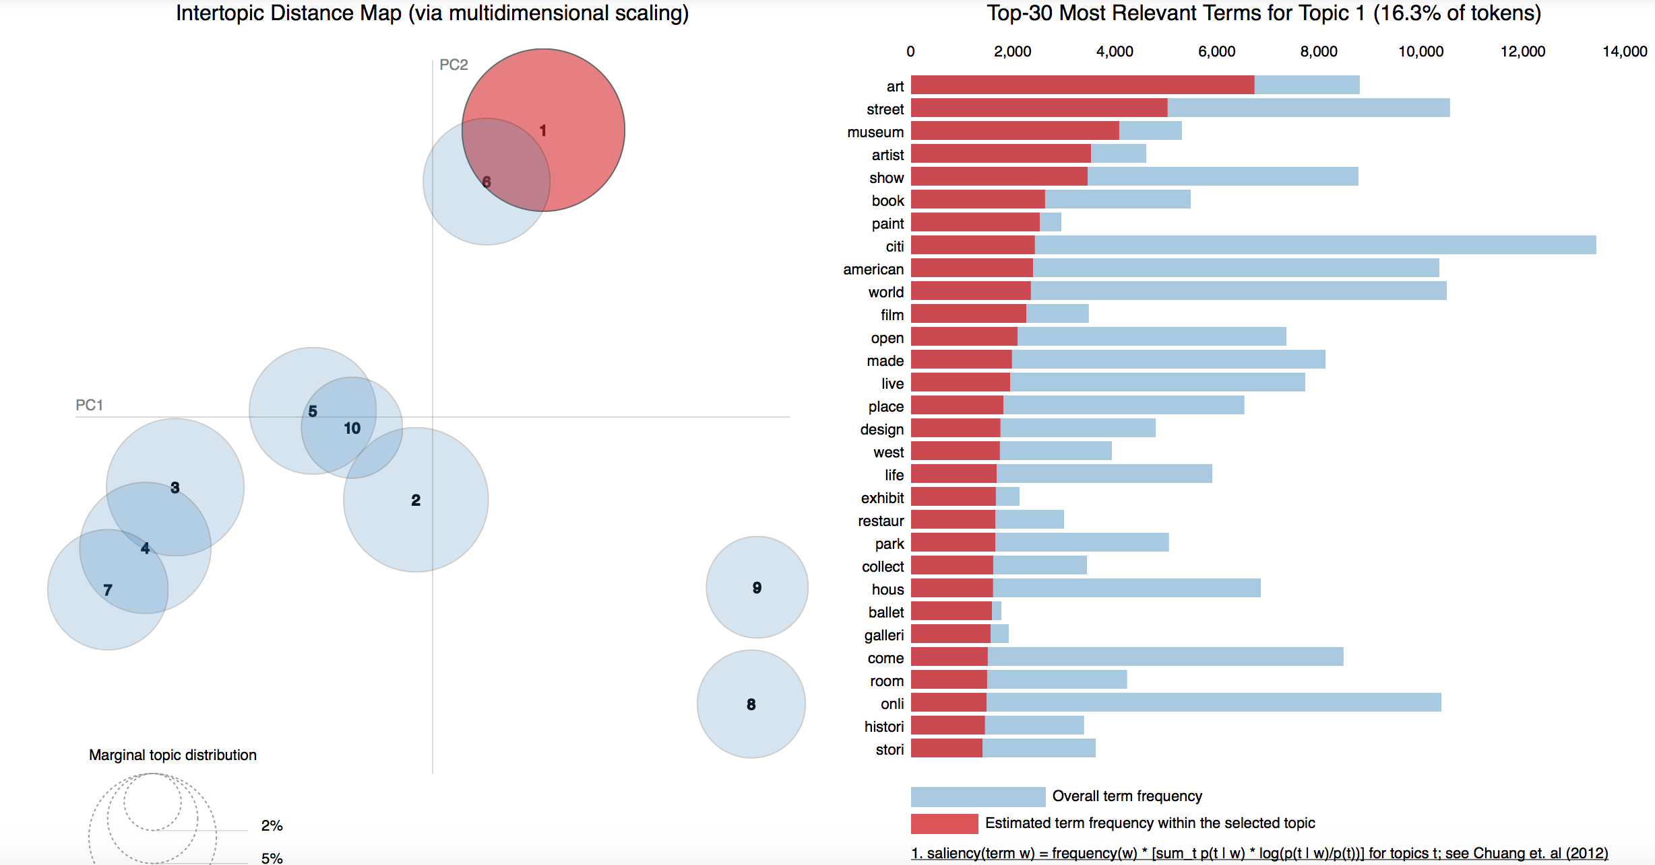
VISUALIZATION MADE SIMPLE: PYLDAVIS

Slide 25
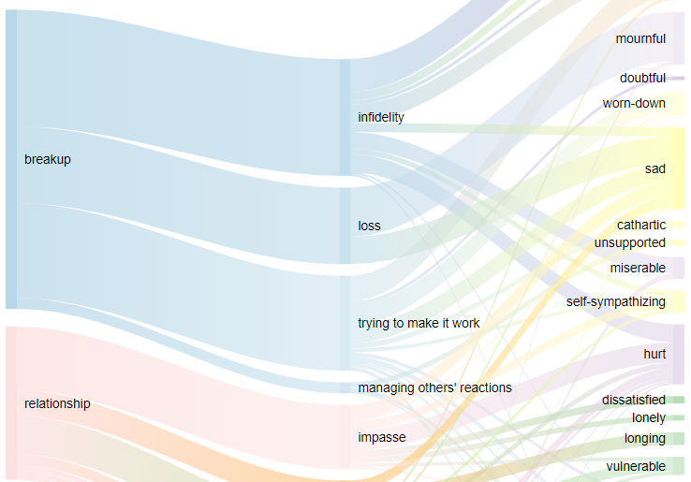
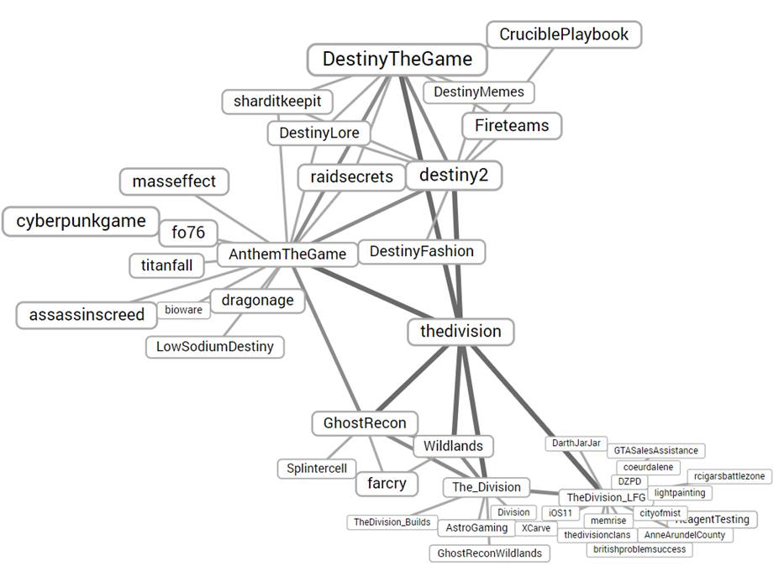
VISUALIZATION : THINKING OUTSIDE THE BOX

Slide 26
KEY TAKEAWAYS: WHAT SHOULD I USE?
1
Short texts: LDA or Biterm Topic Modeling
2
Topic evolution overtime : Hierarchical Dirichlet Process? Dynamic Topic Modeling?
3
Really precise subjects with lots of unusual words: LDA2Vec

Slide 27
KEY TAKEAWAYS: HOW SHOULD I VISUALIZE IT?
1
If you are working with expert users : T-SNE / PyLDAVis / Sankey
2
If you are working with users unfamiliar with the subject : PyLDAVis (with a time dedicated to explain how it works) / a hand-crafted visualization.
3
If you are trying to compare subjects shared between sets of documents : Network representation

Slide 28


THANKS!
28

